Slide 1


Condesa and Condesa Iztapalapa
Specialized Clinics
Centro para la Prevención y Atención Integral del VIH de la Ciudad de México
Clínica Especializada Condesa
Clínica Especializada Condesa Iztapalapa
Mexico City
HIV Program

Slide 2
Total HIV tests performed by year at Condesa and Condesa Iztapalapa Clinics
Up to December, 2018
Proporción:
11.8%³
Positives:
4,229
Proporción:
11.8%³
Positives:
3,829
Proporción:
12.3%³
Positives:
3,818
Proporción:
12.6%²
Positives:
3,480
Proporción:
13.2%²
Positives:
2,995
10.4%
Proporción:
15.2%²
Positives:
2,876
4.7%
12.2%
Proporción:
15.8%²
Positives:
2,493
21.5%
Proporción:
11.5%¹
Proporción:
11.6%²
Proporción:
3.1%⁴
Positives:
175
Proporción:
4.1%⁴
Positives:
185
Proporción:
4.4%⁴
Positives:
239
Proporción:
4.3%⁴
Positives:
135
Proporción:
6.4%⁴
Positives:
235
Proporción:
3.9%⁴
Positives:
121
Proporción:
5.5%⁴
Positives:
168
Fuente: Sistemas de Información de la Clínica Especializada Condesa
1. Suma de pruebas realizadas a Hombres y Mujeres entre el total de Positivos. Abstract THPE0288 “Hacia el diagnóstico de VIH / ITS en tiempo real en el programa de VIH / SIDA de la Ciudad de México”. L. Juárez-Figueroa; J. Arellano; P Iracheta; A. González. XVIII AIDS Conference.
2. Data 2011, 2012, 2013, 2014 y 2015: Sistemas de información. Laboratorio Especializado Condesa.
3. Data 2016, 2017, 2018 Sistemas de información. Laboratorio Especializado Condesa, y Laboratorio Especializado Condesa Iztapalapa
4. Personas en reclusión, Hospitales y Clínicas

Slide 3
Total of persons detected HIV positive at
Condesa Specialized Clinics, 2011 - 2018
Fuente: Sistemas de Información de la Clínica Especializada Condesa. Sistema HexaLIS

Slide 4
Proportion of HIV positive tests
2012 - 2018
Clínicas Especializadas Condesa
%

Slide 5
HIV tests performed by gender at Condesa and Condesa Iztapalapa Clinics
Clínicas Especializadas Condesa - 2018
15.3%
Total:
25,416
84.7%
2.6%
Total:
10,090
97.4%
17.2%
Total:
384
82.8%
 | Negatives | Positives | Total | % HIV +
Number of tests | 31,661 | 4,229 | 35,890 | 11.8%
Number of persons | 25,523 | 4,146 | 29,669 | 14.0%
Fuente: Sistemas de información. Sistema del Laboratorio Especializado Enero a Diciembre de 2018

Slide 6
HIV Prevalences in MARPs
Condesa Clinics
Population Group | HIV Prevalence
Transgender Women | 37%
n= 1,300
Male Sex Workers | 37%
n= 627
MSM | 19%
n= 15,547
Females partners of HIV+ men* | 3%
n= 7,110
Male Prisoners* | 1%
n= 33,000
Female Prisoners* | 1.10%
n= 3,000
Pregnant Women- CDMX | 0.22%
Subway Clinics n= 6,096
Public Health Clinics n= 8,173
Total tests done n= 14,269
Drug Users *** | 1%
n=1,615
*Prevalence of project “Ponte a Prueba” 2010-2014.
** Seroprevalence of Mexican population 15 through 49 years: results from Ensanut 2012. Artículo revista Salud Pública de México / vol. 56, no. 4, julio-agosto de 2014
*** Prevalences of Departmental Unit of Specific Programs

Slide 7
HIV testing in men
Clínicas Especializadas Condesa - 2018
n= 20,465
Men
VIH+
15.2%
VIH+
18.8%
VIH+
23.5%
39.1%
33.5%
27.3%

Slide 8
HIV Prevalence in adolescents
Condesa Clinics
9.5%
5.9%
3%
0.66%

Slide 9
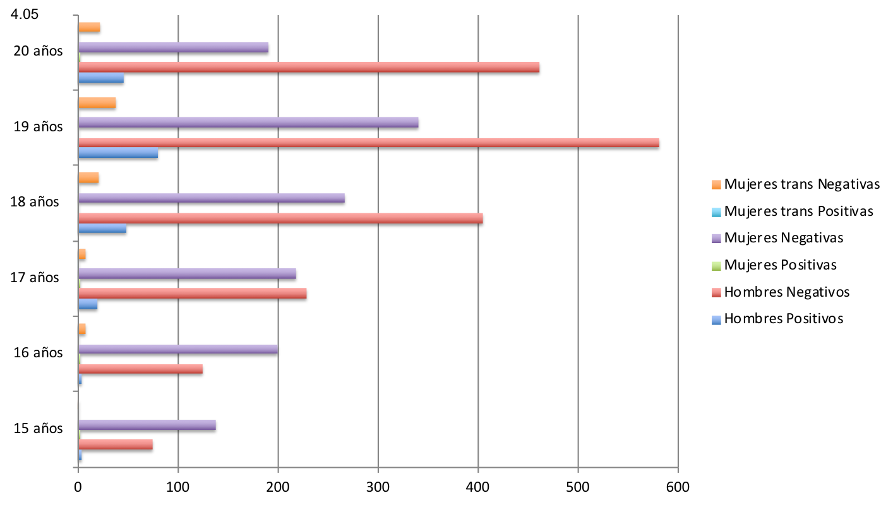
HIV Prevalence in adolescents by age
Condesa Clinics
8.8%
12.1%
10.6%
7.7 %
3.1 %
3.89 %
Notes:
4.054054054 3.225806452 8.333333333 11.85185185 13.76936317 9.74025974

Slide 10
HIV in adolescents
Condesa Clinics
53/211 (25.1%) lost to follow-up: 52 men, y 1 TGW. Mean: 18 yo.
Mean CD4+ cells (n=115): 406 cel/mm3. (14.7% <200 CD4+)
Median number of sex partners: 24 (vs. 11 in controls)
26% with sex partner 10 or more years older (vs. 10% in controls)
26% had an adolescent mother (vs. 13% in controls)
25% had suffered sexal abuse (vs. 17% in controls)
64% used a condom in first sexual intercourse (vs. 68% in controls)

Slide 11
Test and Treat and Test and PrEP
HIV
(+)
(-)
Test and Treat
Test and PrEP
Risk Assessment
Linkage
Services for MARP´s:
PEP
PrEP
Other prevention tools
Medical Care
Lab tests
Retention
Linkage
HIV & STI testing
Adherence
PrEP
Viral supression
Adherence

Slide 12
From Diagnosis to Linkage-to-care
2017-2018
2017
28,143
Persons tested
238
Previous diagnosis
3,811
HIV-positive
1,568 (43.8%)
Linked to care in Condesa Clinics
Condesa | 1,016
Iztapalapa | 353
Not yet on ART | 199
3,573 (100%)
New
diagnosis
568 (15.9%)
Lost to follow-up
1,434 (40.1%)
Transfered to other institutions
Federal Hospitals | 152
State of Mexico | 328
Other States | 137
IMSS (Social Security) | 778
ISSSTE (Gov’t Social Security) | 42
2018
54.2%
of those refered to other institutions
27,177
Persons tested
205
Previous diagnosis
3,204
HIV-positive
1,460 (48.6%)
Linked to care in Condesa Clinics
Condesa | 910
Iztapalapa | 395
Not yet on ART | 155
2,999 (100%)
New
diagnosis
422(14.0%)
Lost to follow-up
1,117 (37.2%)
Transfered to other institutions
Federal Hospitals | 81
State of Mexico | 238
Other States | 145
IMSS (Social Security) | 615
ISSSTE (Gov’t Social Security) | 38
Source:: Cruce de bases de Laboratorio de la Clínica Especializada Condesa (31/Dic/17), Base SALVAR (30/Sep/18) y Base Trabajo Social.
Análisis de sistemas de Información de la CEC.
55.0%
of those refered to other institutions

Slide 13
Active Patient at Condesa Specialized and Condesa Iztapalapa Specialized Clinics
2009 - 2018
Year | Patients On Care | % Increase
2008 | SIN DATOS
2009 | 5,016
2010 | 5,814 | 15.9%
2011 | 7,596 | 30.7%
2012 | 8,401 | 10.6%
2013 | 9,428 | 12.2%
2014 | 10,652 | 13.0%
2015 | 11,714 | 10.0%
2016 | 13,167 | 12.4%
2017 | 14,771 | 12.2%
2018 | 15,734 | 6.5%
Average |  | 13.7%
Average Increase: 13.7%
Se incluyen pacientes VIH positivos en control sin ARV, y pacientes que reciben tratamiento antirretroviral.
Estimación realizada con la base de datos SALVAR al 31 de Diciembre de 2018. A partir de 2016 se incluyen datos de la Clínica Condesa Iztapalapa
Fuente: Sistemas de Información de la Clínica Especializada Condesa

Slide 14
PATIENTS ON ART FOR 6 MONTHS OR MORE
Condesa Clinics - 2014 through 2018*
95.6% of all patients linked to care are on ARV treatment
95.0%
<1,000 copies
94.3%
<1,000 copies
93.8%
<1,000 copies
96.0%
<1,000 copies
69.6%
<50 copies
87.4%
<40 copies
86.9%
<40 copies
85.3%
<40 copies
89.1%
<40 copies
Fuente: Sistemas de Información de la Clínica Especializada Condesa con datos del Sistema SALVAR

Slide 15
PRE-TREATMENT DRUG RESISTANCE
Condesa Clinics – 2016-2018
N = 2,447
09/2016-06/2018
Pretreatment drug resistance (%)
Avila-Rios, S, et al

Slide 16
Antiretroviral Treatment – Initial HAART
Clínicas Especializadas Condesa - 2015 to 2018
Fuente: Sistemas de Información. Sistema SALVAR al 30 de septiembre de 2018

Slide 17
Mexico City HIV/AIDS Program
Outreach and Population-Specific Programs
Population | Program
Male Sex Workers | “Punto Seguro” (“Safe Spot”)
Transgender Women | Transgender Clinic
Women | Reproductive & Sexual Health Care & STI
Female Sex Workers | Reproductive & Sexual Health Care & STI
Pregnant Women | Reproductive & Sexual Health Care & STI
MSM | All male programs offer services
Prison Inmates | Access to VCT & Treatment “Ponte a Prueba” (“Test Yourself”)
Sexual Violence Victims | Reproductive & Sexual Health Care & STI
Drug users | Harm Reduction Program
Serodiscordant couples | Acute HIV Program
Acute infection | Acute HIV Program

Slide 18

Condesa Specialized Clinic Transgender Centre
Cascade of HIV Care 2009-2018 in Transgender Women
HIV Positive: 28.8%
82.8%
88.7%
94.5%
N=374
n=310
n=275
n=260
Source: * Database of the Center for Care of Transgender People CEC / CECI, 2018.

Slide 19
HIV Care in Prison Inmates
100
n= 209
Fuente: Sistema SALVAR
Programa de cárceles

Slide 20
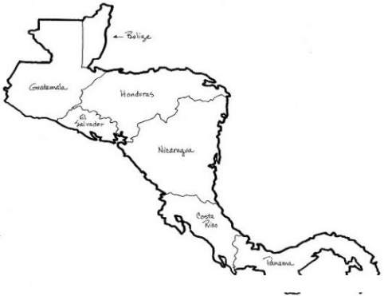
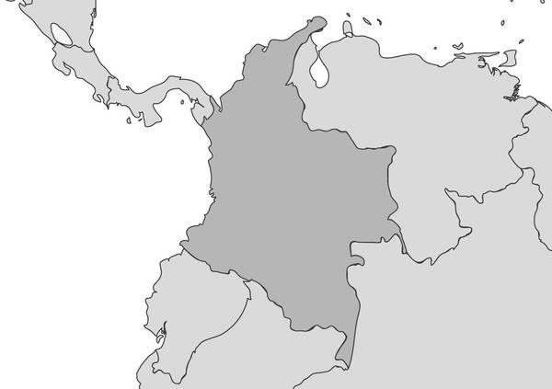
Foreigners women and men receiving HIV care at the Condesa Specialised Clinics – 06/2018
State | Total registry | Foreigners registry | Proportion
Mexico City | 26,814 | 941 | 3.5%
Country | % of all the patients
VENEZUELA | 20.3
COLOMBIA | 16.4
CENTRAL AMERICA | 13.6
HONDURAS | 5.4
EL SALVADOR | 3.3
GUATEMALA | 1.6
COSTA RICA | 1.5
NICARAGUA | 0.9
BELICE | 0.5
PANAMA | 0.4
OTHER COUNTRIES | 49.7
Central America
13.6%
Venezuela
20.3%
Colombia
16.4%
Source: National System (SALVAR), June, 2018

Slide 21
Foreigners Voluntary HIV Counselling and Testing (VCT)
01/2017-06/2018
Country | Frequency | Total | % of all the patients
VENEZUELA | 198 | 198 | 17.5
Central America
HONDURAS | 63
GUATEMALA | 28
EL SALVADOR | 35
COSTA RICA | 15
NICARAGUA | 8
PANAMA | 11 | 160 | 14.1
North America
UNITED STATES | 106
CANADA | 15 | 121 | 10.7
South America
COLOMBIA | 150
ARGENTINA | 61
BRAZIL | 32
CHILE | 27
PERU | 25
BOLIVIA | 5
ECUADOR | 7
URUGUAY | 6
PARAGUAY | 4 | 317 | 28.0
Caribbean
CUBA | 29
DOMINICAN REPUBLIC | 6
PUERTO RICO | 3
HAITI | 1 | 39 | 3.4
Total |  | 835 | 73.6
Country | Frecuency
Other countries
SPAIN | 75
FRANCE | 68
ITALY | 24
ENGLAND | 19
GERMANY | 17
SWITZERLAND | 8
JAPAN | 7
CHINA | 7
BELGIUM | 6
AUSTRALIA | 5
CROATIA | 4
DENMARK | 4
KOREA | 3
HOLLAND | 3
INDIA | 3
GREECE | 3
NIGERIA | 3
PORTUGAL | 3
GRENADA | 3
RUSIA | 3
BULGARY | 2
SWEDEN | 2
AUSTRIA | 2
SLOVENIA | 2
ISRAEL | 2
UKRAINE | 2
CONGO | 1
BANGLADESH | 1
CAMEROON | 1
SOUTH KOREA | 1
SCOTLAND | 1
HONG KONG | 1
INDONESIA | 1
MALAYSIA | 1
NEW ZEALAND | 1
PAKISTAN | 1
MOLDAVIAN REPUBLIC | 1
ROMANIA | 1
TUNISIA | 1
ANGOLA | 1
LIBANO | 1
MACEDONIA | 1
IRAN | 1
VIETNAM | 1
POLONIA | 1
Total from all the countries | 1,134
HIV Prevalence
17.9%
203 HIV positives from 1,134 foreigners
The Counselling and Testing Service gathers the largest number of foreigners (1,134 people) attended at the Condesa Specialised Clinic (from January 2017 to June 2018)
Source: Condesa Specialized Clinics Laboratory report

Slide 22
HIV transmission network
Mexico City Metropolitan Area, 2016-2018
Se encontraron asociaciones con al menos una otra secuencia para 963/2,447 (39%) secuencias, formando 99 clusters con tamaño desde 2 a 20 individuos.
Los individuos dentro de clusters fueron más jóvenes (aOR=0.96, p<0.0001), incluyeron una mayor proporción de hombres (aOR=2.3, p=0.001) y una menor proporción de personas que residían fuera de la Zona Metropolitana de la CDMX (aOR=0.11, p=0.003).
Entre los individuos dentro de clusters, 175/963 (18%) compartían mutaciones de resistencia a frecuencia >2% en 66 clusters (considerando solo mutaciones en frecuencia de 2-20%, en 25 clusters).
Avila-Rios, S, et al

Slide 23
HIV transmission network
Mexico City Metropolitan Area, 2016-2018
Gustavo A. Madero
Ecatepec
Iztacalco
Cuauhtémoc
Nezahualcóyotl
Álvaro Obregón
Benito Juárez
Iztapalapa
Eight municipalities concentrate 65% of all the people sharing drug-resistan mutations 8DRM)
Avila-Rios, S, et al

Slide 24
Total de registros en ImPREP México
Unidades: Clínica Especializada Condesa, SETAC Vallarta, México Vivo, INSPIRA, Clínica Condesa Iztapalapa
21.1%
10.6%
10.0%
32.0%
50.3%
8.4%
Total
acumulado:
804 607 133
Datos de ImPReP México al 30 Noviembre del 2018
Sistemas de Información de la Clínica Especializada Condesa

Slide 25
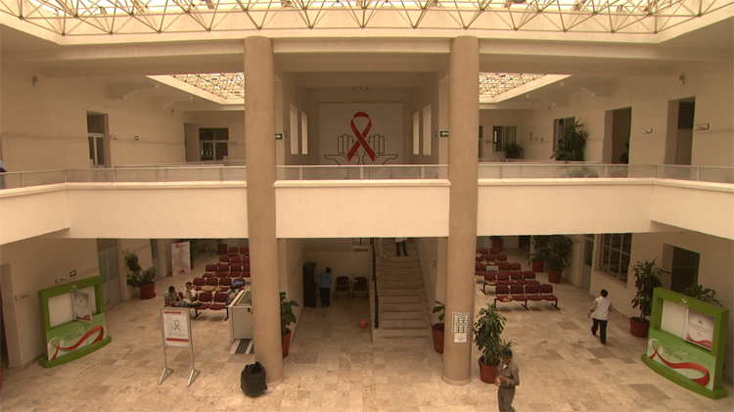
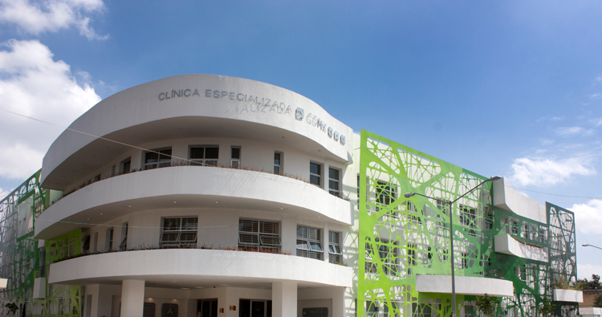
Clínica Especializada Condesa
Clínica Especializada Condesa Iztapalapa
“Dr. Jaime Sepúlveda Amor”
www.condesadf.mx

